Slide 1
CAP456- Introduction to BIG DATA
UNIT II:
BUSINESS MOTIVATION AND DRIVERS FOR BIG DATA ADOPTION

Slide 2
Quick Quiz
analytics that are carried out in an attempt to determine the outcome of an event that might occur in the future- is
Descriptive Analytics
Diagnostic Analytics
Predictive Analytics
Perspective Analytics

Slide 3
Big Data in Marketing
Why it’s Important
Where it’s Going, and
How to Get Started

Slide 4
Big Data in Marketing
“Without big data analytics, companies are blind and deaf, wandering out onto the Web like deer on a freeway.”
When author Geoffrey Moore tweeted that statement back in 2012, it may have been perceived as an overstatement. Now, big data is universally accepted in almost every vertical, not least of all in marketing and sales. While Moore’s tweet referred specifically to big data analytics, the same is true for all aspects of big data, including data ingestion, integration, storage, and more.

Slide 5
Big Data in Marketing
Whether you are trying to improve customer loyalty and engagement, optimize your performance, or make pricing decisions, big data in marketing has proven to be an indispensable tool.
But how is big data transforming marketing and sales?
It certainly comes with challenges. We need to leverage cloud technology and curate, filter, process, and analyze the vast amounts of data we gather.
Fortunately, there are innovative solutions to tackle these challenges.

Slide 6
How Big Data is transforming marketing and sales
In marketing, big data comprises gathering, analyzing, and using massive amounts of digital information to improve business operations, such as:
Getting a 360-degree view of their audiences. The concept of “know your customer” (KYC) was initially conceived many years ago to prevent bank fraud. KYC provides insight into customer behavior that was once limited to large financial institutions. Now, because of the accessibility of big data, the benefits of KYC are available to even small and medium businesses, thanks to cloud computing and big data.

Slide 7
How Big Data is transforming marketing and sales
Customer engagement, specifically how your customers view and interact with your brand, is a key factor in your marketing efforts.
Big data analytics provides the business intelligence you need to bring about positive change, like improving existing products or increasing revenue per customer.

Slide 8
How Big Data is transforming marketing and sales
Brand awareness is another way big data can have a significant impact on marketing. Aberdeen Group’s Data-Driven Retail study showed that “data-driven retailers enjoy a greater annual increase in brand awareness by 2.7 times (20.1% vs. 7.4%) when compared to all others.

Slide 9
How Big Data is transforming marketing and sales
The 360-degree view from big data allows marketers to present customer-specific content when and where it is most effective to improve online and in-store brand recognition and recall. Big data allows you to be the Band-Aid of your product category even if you don’t have the marketing budget of Johnson & Johnson.

Slide 10
How Big Data is transforming marketing and sales
Improved customer acquisition is another great benefit that big data brings to marketing. A McKinsey survey found that “intensive users of customer analytics are 23 times more likely to clearly outperform their competitors in terms of new customer acquisition.” Leveraging the cloud allows for the gathering and analysis of consistent and personalized data from multiple sources, such as web, mobile applications, email, live chat, and even in-store interactions.

Slide 11
How Big Data is transforming marketing and sales
Big data can help marketers leverage real-time data in cloud computing environments. The ability of big data to acquire, process, and analyze real-time data quickly and accurately enough to take immediate and effective action cannot be matched by any other technology. This is critical when analyzing data from GPS, IoT sensors, clicks on a webpage, or other real-time data.
Big data analytics is an essential component of big data. It provides business intelligence that results in time and cost savings by optimizing marketing performance.

Slide 12
Three types of big data for marketers
Marketers are interested in three types of big data: customer, financial, and operational. Each type of data is typically obtained from different sources and stored in different locations.
Customer data helps marketers understand their target audience. The obvious data of this type are facts like names, email addresses, purchase histories, and web searches. Just as important, if not more so, are indications of your audience’s attitudes that may be gathered from social media activity, surveys, and online communities.
Financial data helps you measure performance and operate more efficiently. Your organization’s sales and marketing statistics, costs, and margins fall into this category. Competitors’ financial data such as pricing can also be included in this category.
Operational data relates to business processes. It may relate to shipping and logistics, customer relationship management systems, or feedback from hardware sensors and other sources. Analysis of this data can lead to improved performance and reduced costs.

Slide 13
Dynamics Business Architecture
Data is often considered to be the crown jewels of an organization. It can be used in myriad ways to run the business, market to customers, forecast sales, measure performance, gain competitive advantage, and discover new business opportunities.
And lately, a convergence of new technologies and market dynamics has opened a new frontier for information management and analysis

Slide 14
Dynamics Business Architecture
This new wave of computing involves data with far greater volume, velocity, and variety than ever before. Big Data, as it is called, is being used in ingenious ways to predict customer buying habits, detect fraud and waste, analyze product sentiment, and react quickly to events and changes in business conditions.
It is also a driving force behind new business opportunities

Slide 15
Dynamics Business Architecture
To run the business, you organize data to make it do something specific; to change the business, you take data as-is and determine what it can do for you.
These two approaches are more powerful together than either alone. In fact, many innovative solutions are a combination of both approaches.

Slide 16
Dynamics Business Architecture
For instance, a major European car manufacturer is collecting data via telematics from cars they produce. This data is used to influence offers they make to their customers.
It is also used to better understand the conditions that the car has experienced, which in turn helps in root-cause failure analysis as well as in future automobile design.

Slide 17
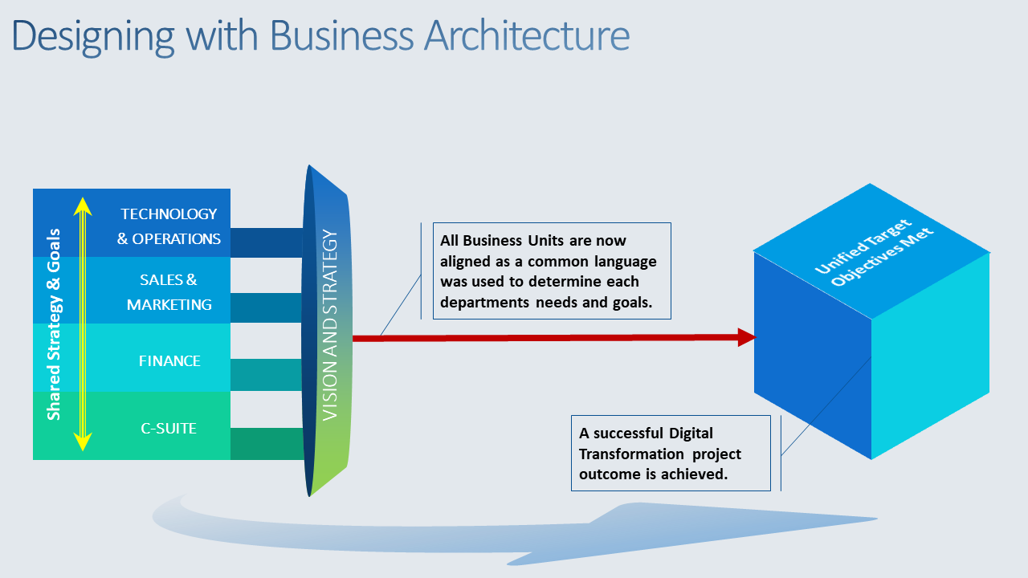
Dynamics Business Architecture

Slide 18
Business Process Management
A business process management (BPM) refers to a set of activities carried out by humans to achieve one or more business goals. BPs are occur in several sectors: marketing, healthcare, financial management and of course business. BPs generate a significant amount of data known as big data.
In recent years, the management of business process models and data is very challenging. On one hand, business process must be powerful in terms of modeling. On another hand, big data analytics support to find suitable knowledge to enact business process models.

Slide 19
Business Process Management
Business processes involve input and output. Examples of business processes are employee recruitment, manufacturing, and customer engagement. We will discuss how data analytics can improve business performance and repair broken business processes. It is a valuable resource for a business that is looking to introduce or widen the application of big data analytics in business process management.

Slide 20
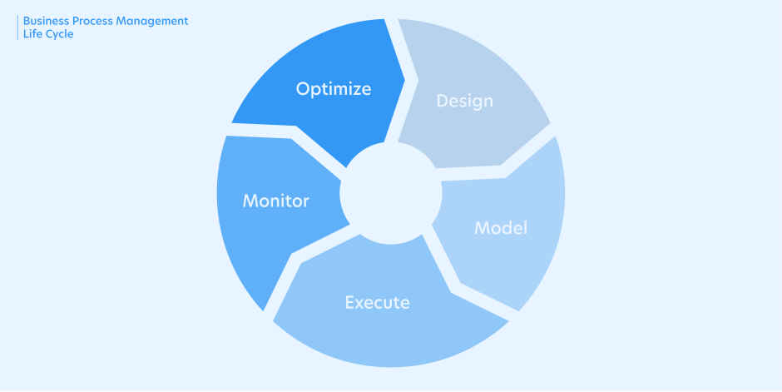
Business Process Management

Slide 21
1. Process Design
It all begins with the identification of the business processes that needs automation. The next step is to write down the existing procedures, actions, decisions and the people involved. A mock-up form also comes in handy here as it aids in the collection and display of data. Once it has collected and displayed the needed data, the form can be routed using the review-and-approval workflow.

Slide 22
2. Business Process Modelling
Business process modeling maps out the future beginning from the current level {as-is) going to the future (or “to-be”), using written documentation detailing all the relevant data steps needed for action and implementation.
The process follows the form clearly and logically outlined where every task is assigned to a particular participant. The following process illustration is for a typical capital expenditure approval request.
Start > Initiator completes form > manager seeks clarification > Initiator updates form and resubmits form > manager approves request > CFO approval > end.

Slide 23
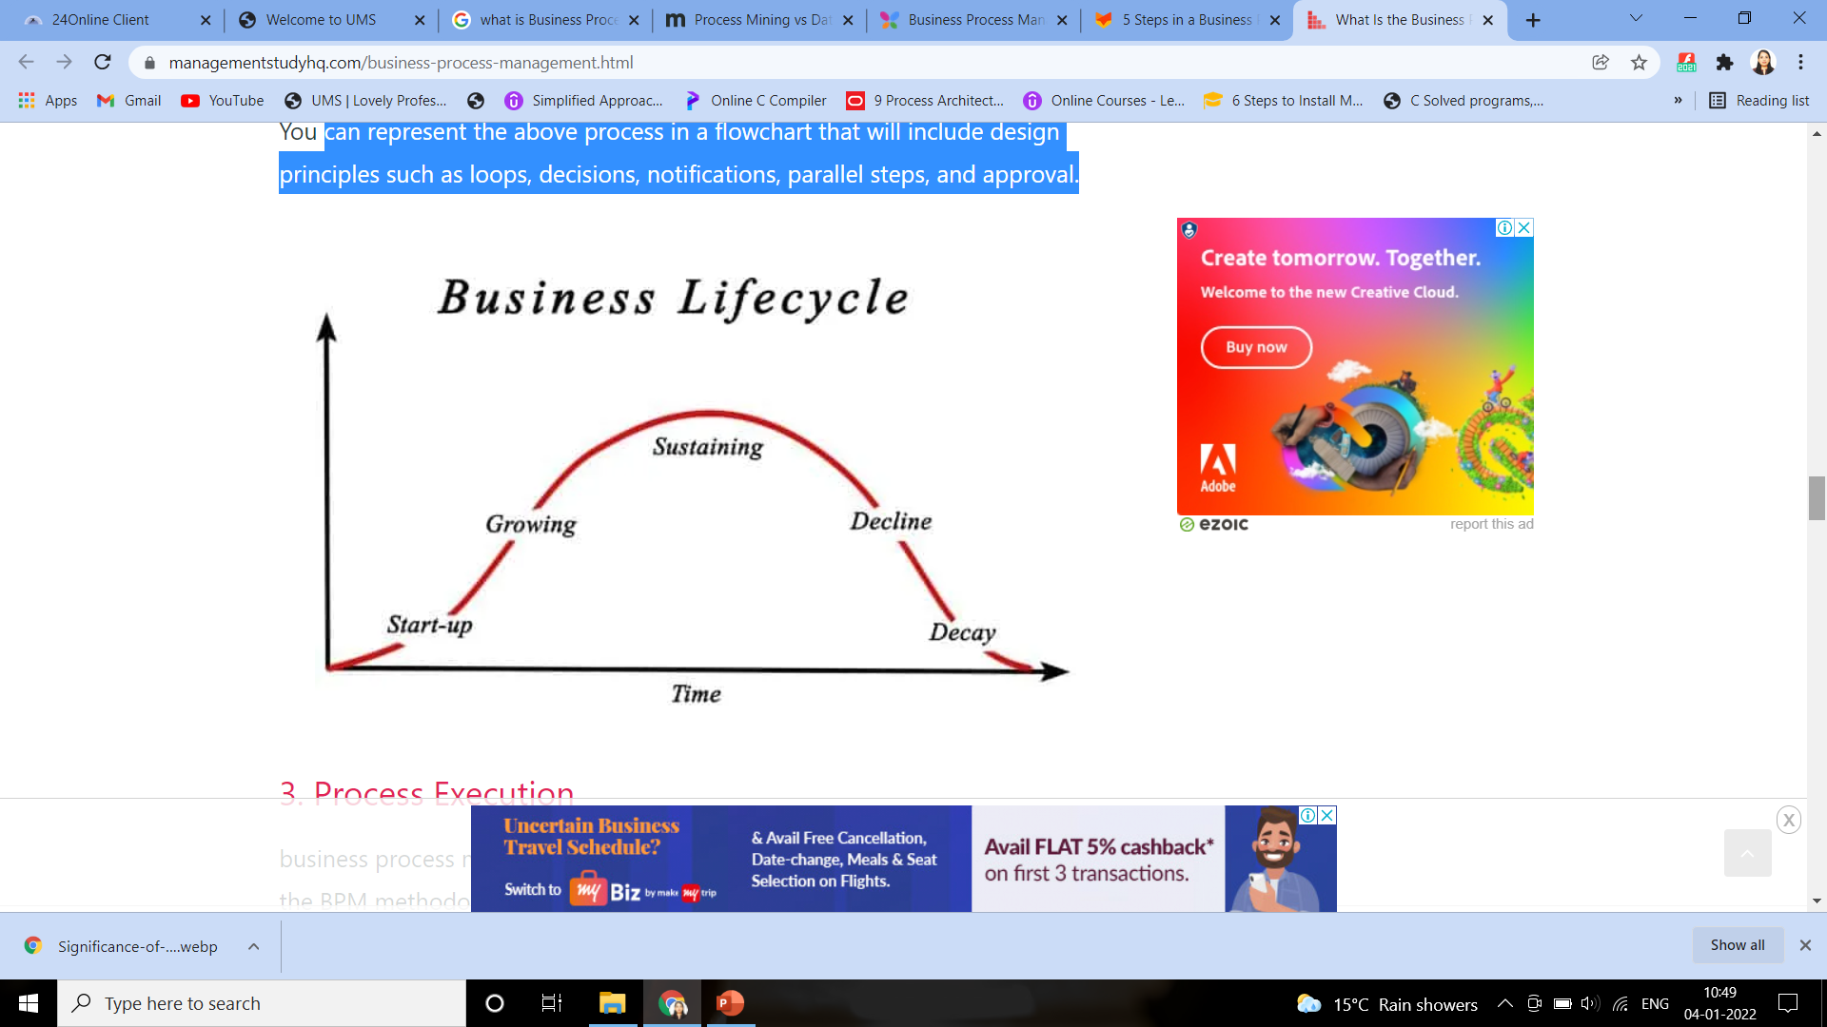
2. Business Process Modelling
We can represent the above process in a flowchart that will include design principles such as loops, decisions, notifications, parallel steps, and approval.

Slide 24
3. Business Process Execution
Business process management software (BPMS) is needed to efficiently execute the BPM methodology as stated out during the design and modeling stages. Indeed, there is the possibility of manual execution, although such will be characterized by inefficiencies and will continue to be paper-based.
The best approach here would be to introduce the process to a few trusted individuals first to gain their confidence and get room to fix teething problems that might arise at this point.

Slide 25
4. Business Activity Monitoring
This refers to the evaluation activities performed and data collected with the view of analyzing critical tasks.
The goal here is to accomplish goals faster by getting rid of the time-consuming steps and procedures. The workflow is targeted at ensuring the highest level of efficiency and effectiveness in all the processes. The management has to keenly analyze the key performance indicators to determine if the specific business modeling in question leads to the achievement of the set goals.

Slide 26
5. Business Process Optimization
There’s a “Process Champion” that works to introduce improvements to the workflow/flow by using data to identify and fix the bottlenecks.
If there’s management buy-in, agreed on commercial terms, and reusable components, BPMS can be implemented faster if the inefficient processes are identified and dealt with.

Slide 27
6. Business Process Re-engineering
Re-engineering is recommended when a process becomes inefficient and therefore the only way to restore productivity is to undertake product optimization. In that case, the entire process life cycle has to be re-engineered.

Slide 28
Information and Communication Technology
Information and communications technology (ICT) refers to all the technology used to handle telecommunications, broadcast media, intelligent building management systems, audiovisual processing and transmission systems, and network-based control and monitoring functions. Although ICT is often considered an extended synonym for information technology (IT), its scope is more broad.

Slide 29
Information and Communication Technology
ICT developments have accelerated the pace of Big Data adoption in businesses:
• data analytics and data science
• digitization
• affordable technology and commodity hardware
• social media
• hyper-connected communities and devices
• cloud computing

Slide 30
Data Analytics and Data Science
Enterprises are collecting, procuring, storing, curating and processing increasing quantities of data. This is occurring in an effort to find new insights that can drive more efficient and effective operations, provide management the ability to steer the business proactively and allow the C-suite to better formulate and assess their strategic initiatives.
Ultimately, enterprises are looking for new ways to gain a competitive edge. Thus the need for techniques and technologies that can extract meaningful information and insights has increased.

Slide 31
Data Analytics and Data Science
Computational approaches, statistical techniques and data warehousing have advanced to the point where they have merged, each bringing their specific techniques and tools that allow the performance of Big Data analysis.
The maturity of these fields of practice inspired and enabled much of the core functionality expected from contemporary Big Data solutions, environments and platforms.

Slide 32
Digitization
For many businesses, digital mediums have replaced physical mediums as the de facto communications and delivery mechanism.
The use of digital artifacts saves both time and cost as distribution is supported by the vast pre-existing infrastructure of the Internet.
As consumers connect to a business through their interaction with these digital substitutes, it leads to an opportunity to collect further “secondary” data.

Slide 33
Digitization
For example, requesting a customer to provide feedback, complete a survey, or simply providing a hook to display a relevant advertisement and tracking its click-through rate.
Collecting secondary data can be important for businesses because mining this data can allow for customized marketing, automated recommendations and the development of optimized product features.

Slide 34
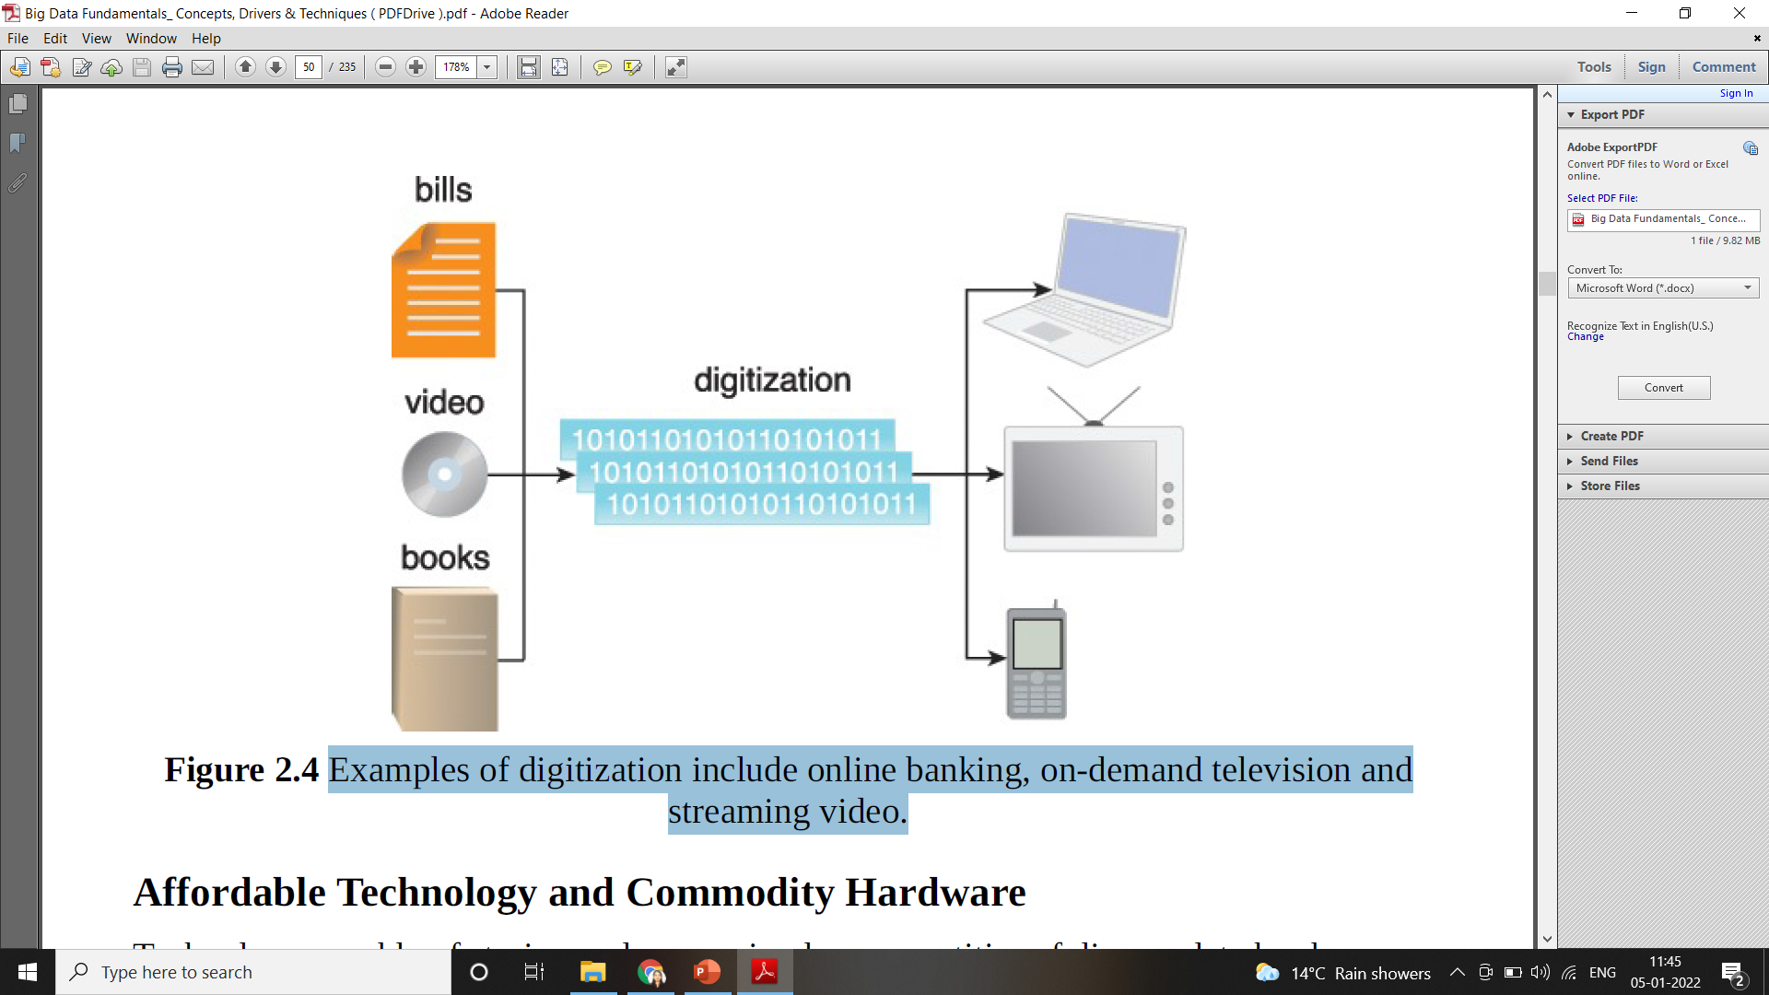
Examples of digitization include online banking, on-demand television and streaming video.

Slide 35
Affordable Technology and Commodity Hardware
Technology capable of storing and processing large quantities of diverse data has become increasingly affordable. Additionally, Big Data solutions often leverage open-source software that executes on commodity hardware, further reducing costs.
The combination of commodity hardware and open source software has virtually eliminated the advantage
that large enterprises used to hold by being able to outspend their smaller competitors due to the larger size of their IT budgets.

Slide 36
Affordable Technology and Commodity Hardware
Technology no longer delivers competitive advantage. Instead, it simply becomes the platform upon which the business executes.
From a business standpoint, utilization of affordable technology and commodity hardware to generate analytic results that can further optimize the execution of its business processes is the path to competitive advantage.

Slide 37
Social Media
The emergence of social media has empowered customers to provide feedback in near real-time via open and public mediums.
This shift has forced businesses to consider customer feedback on their service and product offerings in their strategic planning.
As a result, businesses are storing increasing amounts of data on customer interactions within their customer relationship management systems (CRM) and from harvesting customer reviews, complaints and praise from social media sites.

Slide 38
Social Media
This information feeds Big Data analysis algorithms that surface the voice of the customer in an attempt to provide better levels of service, increase sales, enable targeted marketing and even create new products and services.
Businesses have realized that branding activity is no longer completely managed by internal marketing activities. Instead, product brands and corporate reputation are co-created by the company and its customers. For this reason, businesses are increasingly interested in incorporating publicly available datasets from social media and other external data sources.

Slide 39
Hyper-Connected Communities and Devices
The broadening coverage of the Internet and the proliferation of cellular and Wi-Fi networks has enabled more people and their devices to be continuously active in virtual communities.
Coupled with the proliferation of Internet connected sensors, the underpinnings of the Internet of Things (IoT), a vast collection of smart Internet connected devices, is being formed.
While some streams are public, other streams are channeled directly to corporations for analysis. As an example, the performance-based management contracts associated with heavy equipment used in the mining industry incentivize the optimal performance of preventive and predictive maintenance in an effort to reduce the need and avoid the downtime associated with unplanned corrective maintenance.
This requires detailed analysis of sensor readings emitted by the equipment for the early detection of issues that can be resolved via the proactive scheduling of maintenance activities.

Slide 40
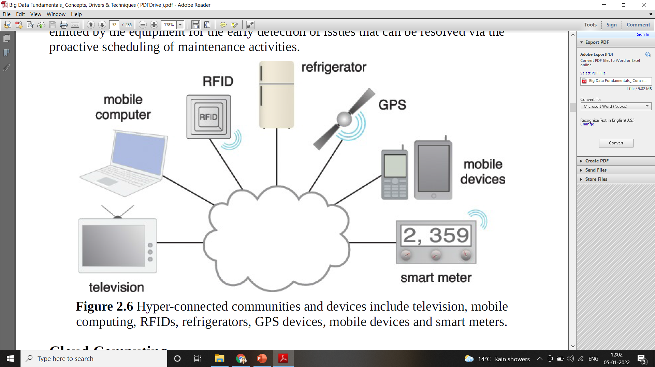
Hyper-Connected Communities and Devices

Slide 41
Cloud Computing
Cloud computing advancements have led to the creation of environments that are capable of providing highly scalable, on-demand IT resources that can be leased via pay-as-you-go models.
Businesses have the opportunity to leverage the infrastructure, storage and processing capabilities provided by these environments in order to build-out scalable Big Data solutions that can carry out large-scale processing tasks.
Although traditionally thought of as off-premise environments typically depicted with a cloud symbol, businesses are also leveraging cloud management software to create on premise clouds to more effectively utilize their existing infrastructure via virtualization.
In either case, the ability of a cloud to dynamically scale based upon load allows for the creation of resilient analytic environments that maximize efficient utilization of ICT resources.

Slide 42
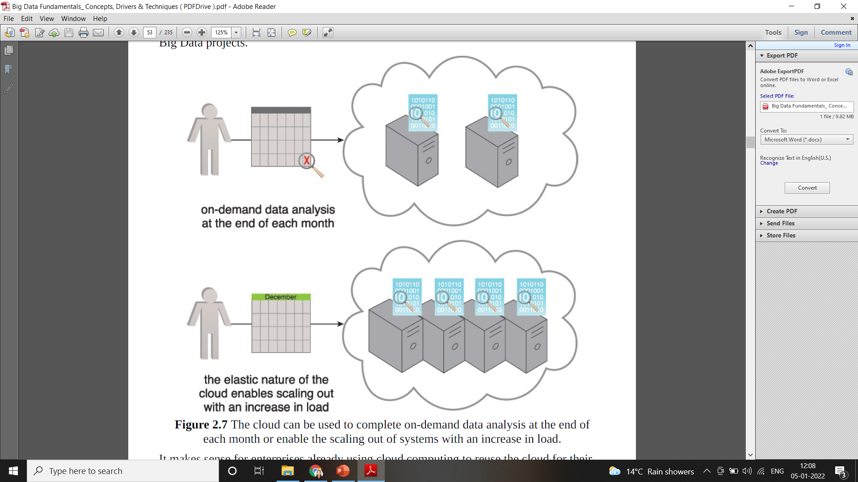
Cloud Computing

Slide 43
Internet of Everything (IoE)
The Internet of Everything was listed as one of the top trends of 2015 by Gartner .The term Internet of Everything (IoE) is a fairly new term , and there is a confusion about the difference between the Internet of Everything (IoE) and the Internet of Things (IoT) , to clarify that, let’s start with definitions , applications and explore the future of this new concept.

Slide 44
Internet of Everything (IoE)
The Internet of Everything (IoE) “is bringing together people, process, data, and things to make networked connections more relevant and valuable than ever before-turning information into actions that create new capabilities, richer experiences, and unprecedented economic opportunity for businesses, individuals, and countries.”, (Cisco, 2013) .

Slide 45
Internet of Everything (IoE)
The Internet of Everything (IoE) “is bringing together people, process, data, and things to make networked connections more relevant and valuable than ever before-turning information into actions that create new capabilities, richer experiences, and unprecedented economic opportunity for businesses, individuals, and countries.”, (Cisco, 2013) .

Slide 46
Internet of Everything (IoE)
In simple terms: IoE is the intelligent connection of people, process, data and things. The Internet of Everything (IoE) describes a world where billions of objects have sensors to detect measure and assess their status; all connected over public or private networks using standard and proprietary protocols.

Slide 47
Internet of Everything (IoE)
Pillars of The Internet of Everything (IoE)
People: Connecting people in more relevant, valuable ways.
Data: Converting data into intelligence to make better decisions.
Process: Delivering the right information to the right person (or machine) at the right time.
Things: Physical devices and objects connected to the Internet and each other for intelligent decision making; often called Internet of Things (IoT).

Slide 48
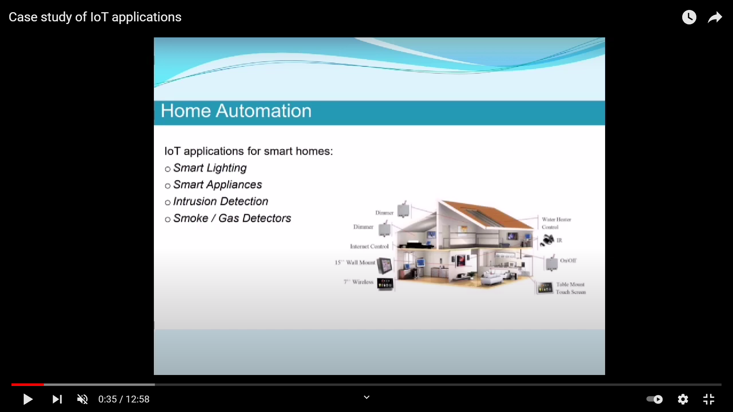
Internet of Everything (IoE) – Case Study Example – Home Automation
IoE applications for smart homes:
Smart lighting
Smart appliances
Intrusion detection
Smoke/Gas detectors

Slide 49
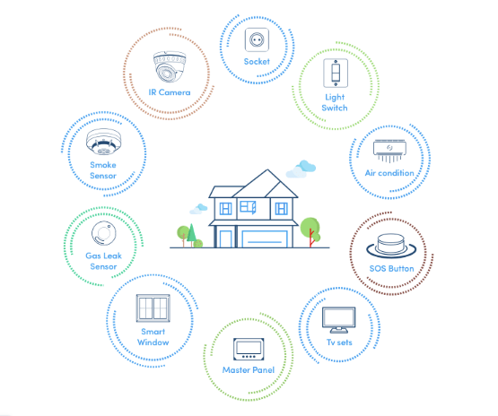
Internet of Everything (IoE) – Case Study Example – Home Automation
IoE applications for smart homes:
Smart lighting
Smart appliances
Intrusion detection
Smoke/Gas detectors

Slide 50
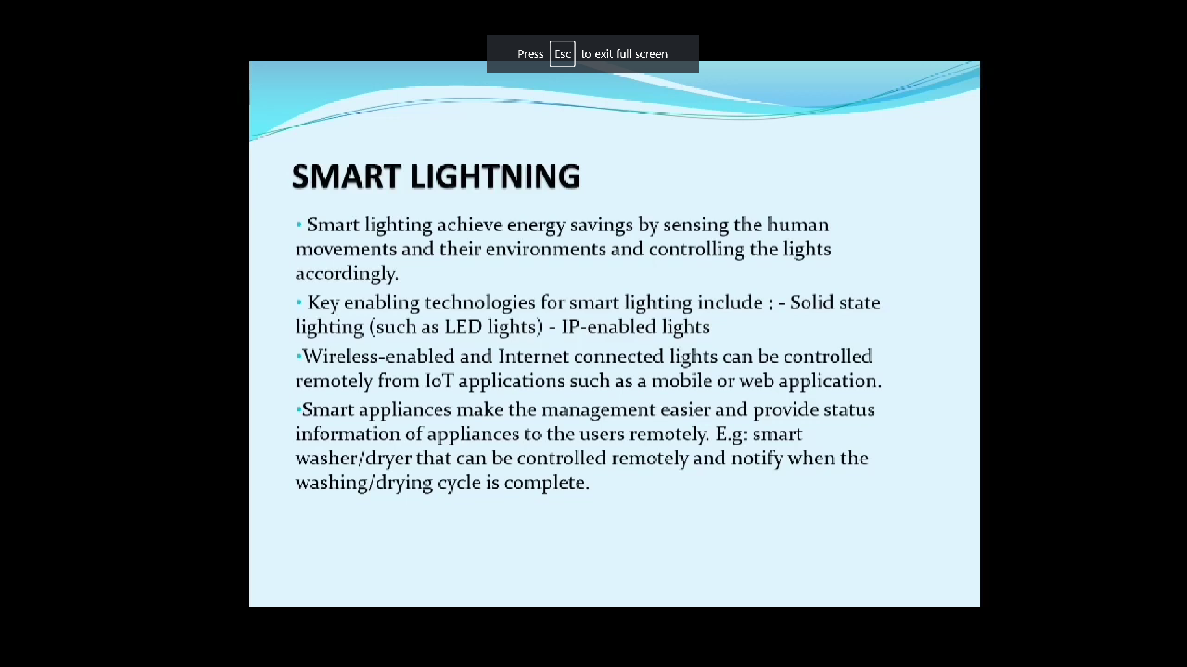

Slide 51
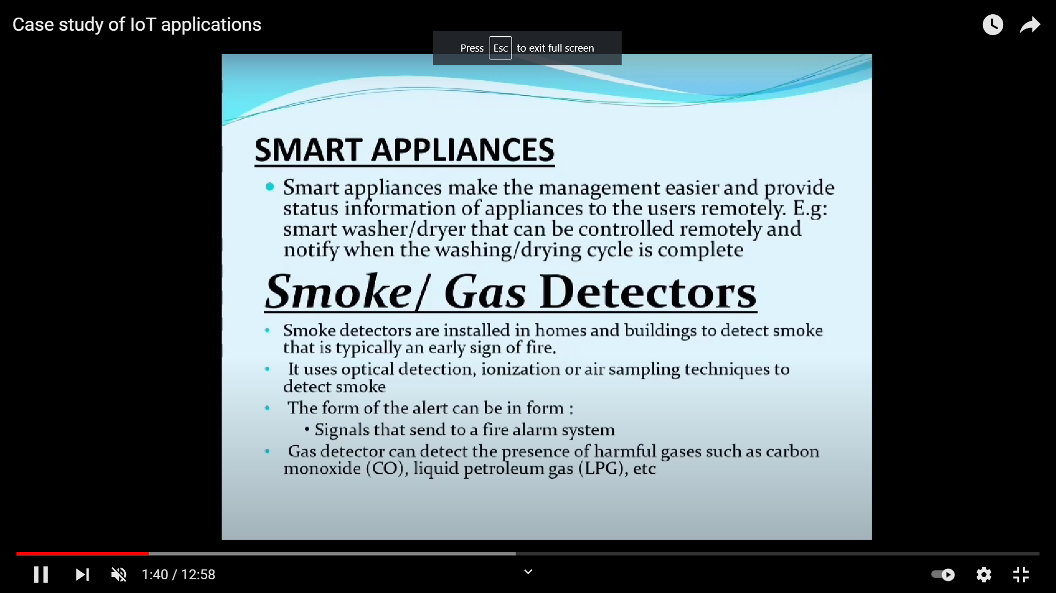

Slide 52
